Slide 1
Russia’s War in Ukraine
Personal Perspective and Context for the Growing Humanitarian Crisis
[Insert Program/Unit Title or Delete]

Slide 2
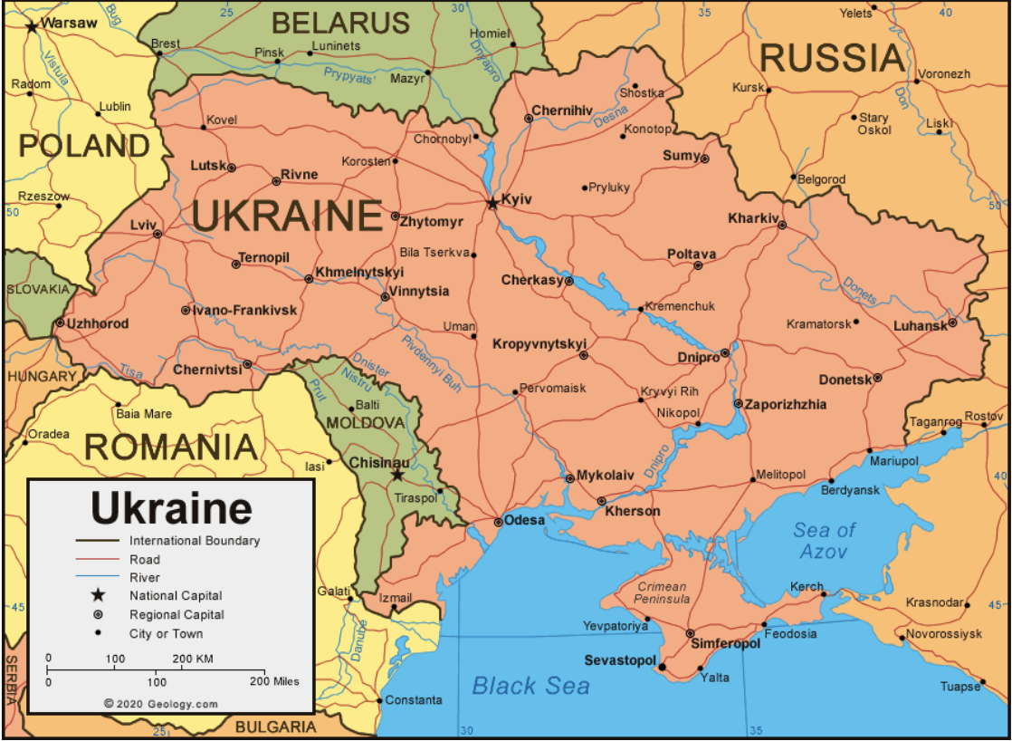
44 mln people
2nd largest in Europe
On August 24th, 1991 became independent
Notes:
First let me share with you some demographic facts. Ukraine is a country of 44 million peace-loving, hospitable people. It’s the 2nd largest European country. There are followers of the three main religions in Ukraine: Christianity, Islam, and Judaism.
Ukraine is multiethnic. About 78% of Ukraine's population identify as ethnic Ukrainians. The second largest nationality group are Russians. Other nationalities include Romanians, Belorusians, Crimean Tatars, Bulgarians, Hungarians, Poles, Armenians, Greeks, and Romas.
Russia and Ukraine were part of the 15 Soviet republics that made up the Soviet Union. Following the collapse of the Soviet Union in 1991, Ukraine declared independence and moved to shed its colonial legacy of Russian domination. It began to form increasingly close ties with the West, and to embrace democratic values. I’ll put a link to short video on how Ukraine became an independent nation into the chat https://www.facebook.com/ukraineworld.org/videos/308335280388114

Slide 3
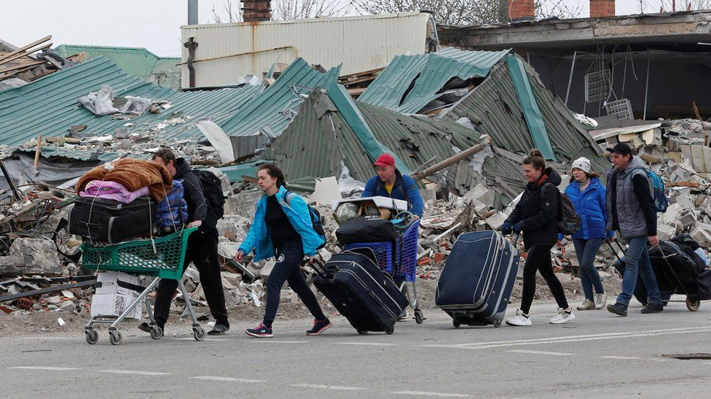
Russia’s Invasion
February 24, 2022 Russia begins full-scale military invasion of Ukraine
More than 12 mln people have fled
5.7 mln to other countries
More than half of all children in Ukraine were forced to leave their homes
1.8 mln children became refugees in other countries

Slide 4
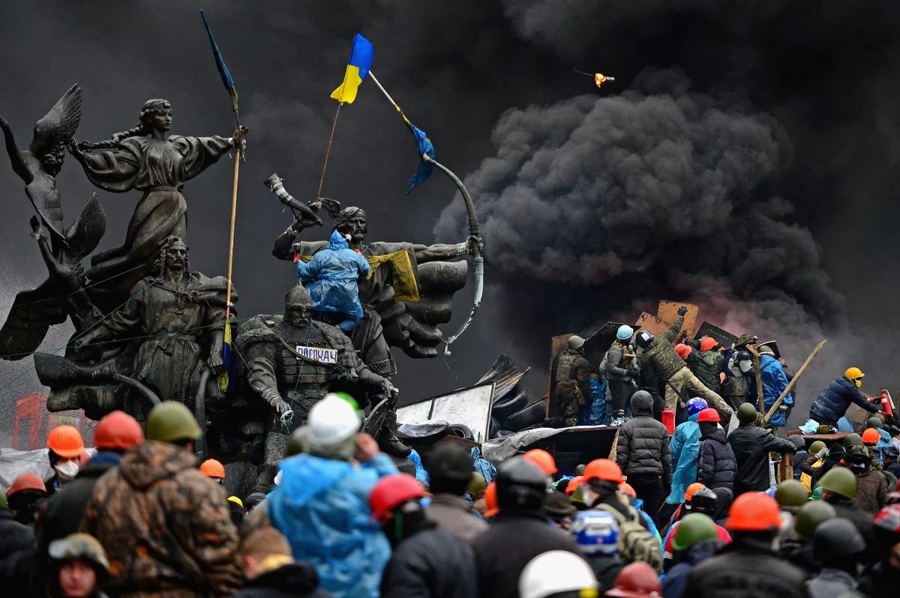
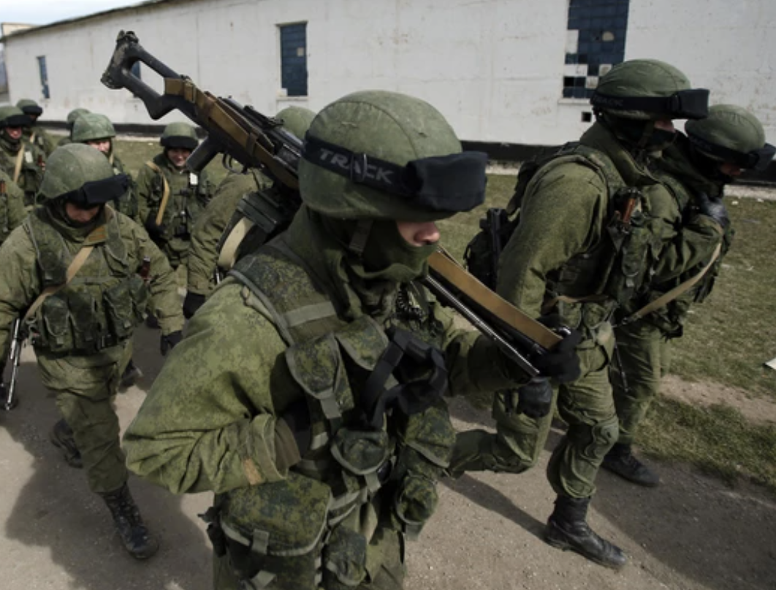
Recent timeline: Russia looms
Revolution of Dignity
2014: Revolution of Dignity: protests break out in Ukraine on Kyiv Independence Square “Maidan”.
More than 100 dead - “Heavenly Hundred”
March-April 2014: Putin finalizes the Russia annexation of Crimea;
40,000 Russian troops enter Ukraine’s Eastern border in Donetsk and Luhansk.
2014-2020: Russia continues military actions in Eatestern Ukraine
Over 14,000 Ukrainians have died; millions as internal refugees
Massive cyber attacks
Russian "little green men" in Crimea.
Notes:
If you are interested in learning about Ukraine’s history, see this timeline. Key points to highlight:
Note when Russia threatened to cut gas supply

Slide 5
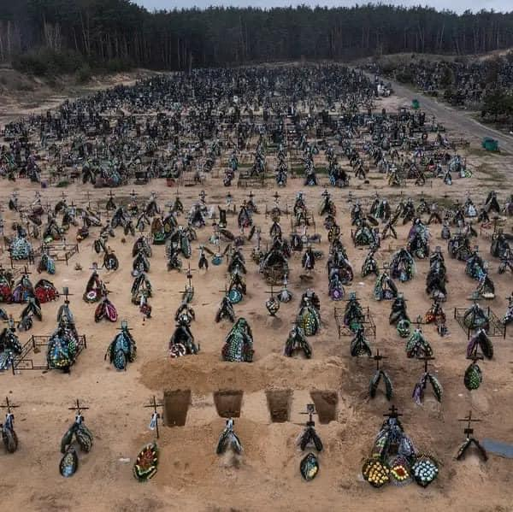
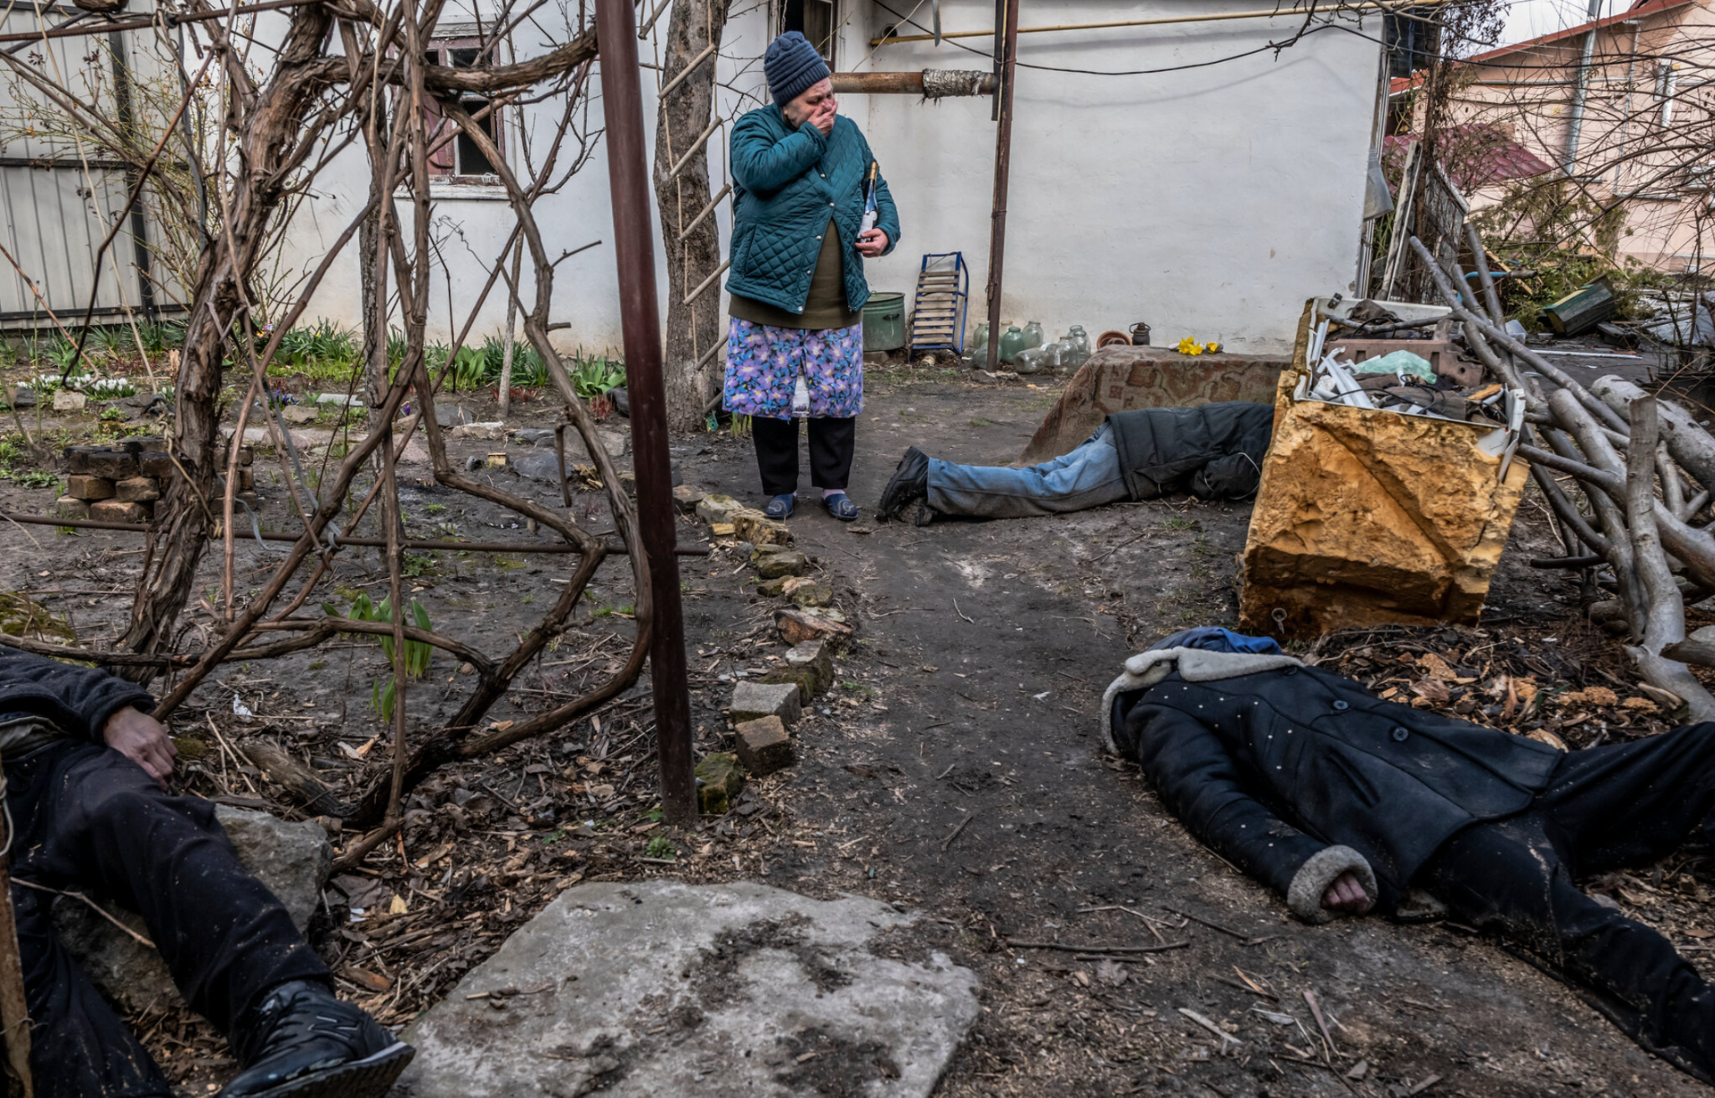
Russia War Crimes
Fresh graveyard in Irpin, near Kyiv
“Bucha’s Month of Terror” NYC investigation
“They shot my son. I was next to him. It would be better if it had been me.”
Notes:
In these slides you see the horrific images of the victims of Russian occupation in the small town of Bucha, near Ukraine’s capital Kyiv. Bucha did not happen in one day. For many years, Russian political elites and propaganda have been inciting hatred, dehumanizing Ukrainians, nurturing Russian superiority, and laying ground for these atrocities. The Ukrainian government encourages scholars around the globe to research what led to Bucha.
The New York Times team visited Bucha, documented dozens of killings of civilians, interviewed scores of witnesses and followed local investigators to uncover the scale of Russian atrocities.
They report that Bucha is a landscape of horrors.
As the Russian advance on Kyiv stalled in the face of fierce resistance, the enemy occupation of Bucha slid into a campaign of terror and revenge. When a defeated and demoralized Russian Army finally retreated, it left behind a grim scene: bodies of dead people on streets, in basements or in backyards, many with gunshot wounds to their heads, some with their hands tied behind their backs.
Reporters and photographers for The New York Times spent more than a week with city officials, coroners and scores of witnesses in Bucha, uncovering new details of execution-style atrocities against civilians. The Times documented the bodies of almost three dozen people where they were killed — in their homes, in the woods, set on fire in a vacant parking lot — and learned the story behind many of their deaths. The Times also witnessed more than 100 body bags at a communal grave and the city’s cemetery.
The evidence suggests the Russians killed recklessly and sometimes sadistically, in part out of revenge.
Ukraine’s official ombudswoman for human rights, Lyudmyla Denisova, said she had recorded horrific cases of sexual violence by Russian troops in Bucha and other places, including one in which a group of women and girls were kept in a basement of a house for 25 days. Nine of them are now pregnant, she said.
She speculated that the violence came out of revenge for the Ukrainian resistance, but also that the Russian soldiers used sexual violence as a weapon of war against Ukrainian women.
Overall, in the broader Bucha region, there were at least 1,000 deaths in the war. The dead are overwhelmingly civilians. Only two members of the Ukrainian military were among those killed in Bucha city. The ombudswoman, Ms. Denisova, appealed to the United Nations Human Rights Commission to “take into account these facts of Russian war crimes in Ukraine.”
The level of brutality of the army of terrorists and executioners of the Russian Federation approved & encouraged by Russian commanders & Putin, knows no bounds, she said.
The Russian government and the Russian army will have to be held accountable politically, economically, and legally for the bombardments, the killings of the men, women, and children and all the war crimes committed in Mariupol, in Bucha, Kharkiv, Irpen, and many other Ukrainian cities, towns, and villages. Our responsibility will be to make sure that the world knows the truth about this war and the perpetrators who started it and committed the despicable atrocities.

Slide 6
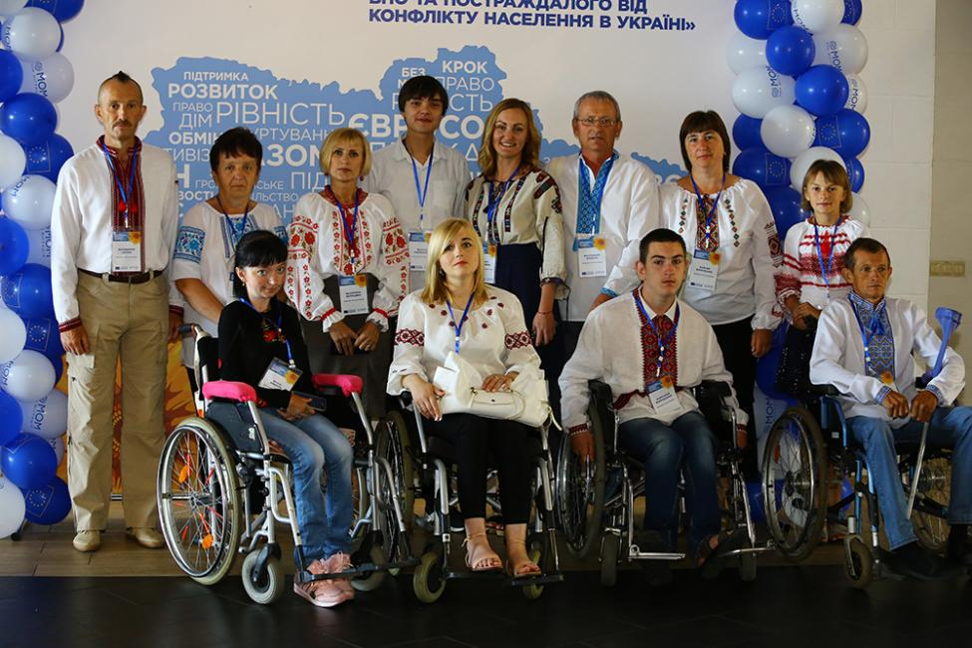
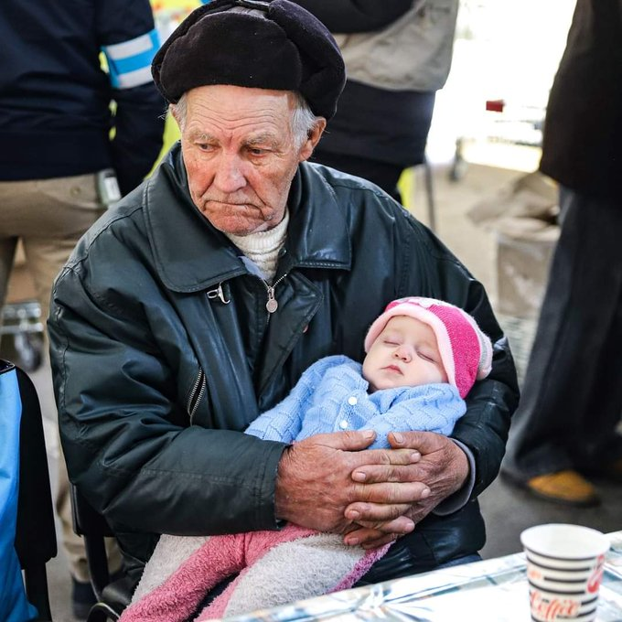
Public health impacts
Health impacts
Vulnerable populations
Health system crises
https://borgenproject.org/aged-and-disabled-in-ukraine/
Notes:
Research shows the aged and disabled in Ukraine also have higher rates of poverty than younger, non-disabled people, making them more vulnerable during disasters. More than one-fifth of Ukraine’s population (more than 9.5 million people) were over the age of 60 in 2018. The country also is facing one of the world’s most acute global crises today. Marginalizing older adults and disabled: not unique to Ukraine and happens in many war torn places. https://borgenproject.org/aged-and-disabled-in-ukraine/
https://www.iom.int/news/iom-ukraine-showcases-its-support-people-disabilities
The risk of infectious disease outbreaks, particularly COVID-19, cholera, polio, tuberculosis, and diarrhoeal diseases, is rising as people are forced to shelter in overcrowded spaces with inadequate or no access to water and sanitation facilities.

Slide 7
Thank you!
Questions?
© 2021 Regents of the University of Minnesota. All rights reserved. The University of Minnesota is an equal opportunity educator and employer. This material is available in alternative formats upon request. Direct requests to 612-624-6669.

